Slide 1







NDHU Events System

Slide 2
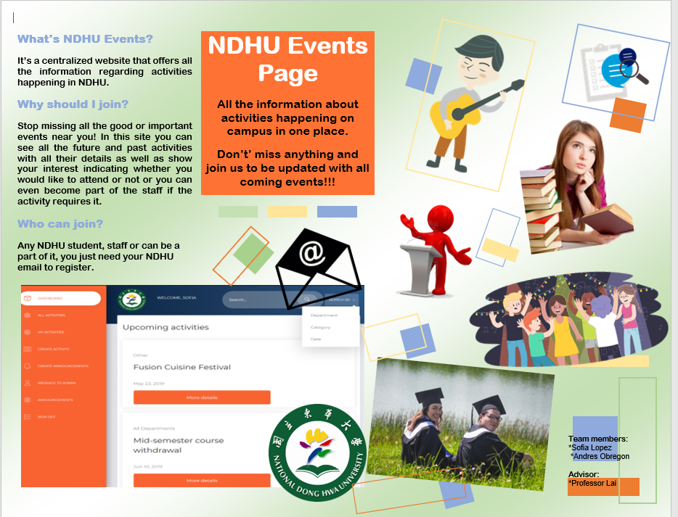
What is NDHU Events System?
Is a centralized website that allows students to know what events and activities are happening on campus in an easier and more organized way.

Slide 3
Motivation
The current ways for students find out about events happening are:
School email
Posters
Some Facebook groups
School website
NDHU doesn’t offer a centralized site where students can go and know what is happening around them in a more organized and easy way.
Many students don’t even check their email, so they miss some events they would like to attend because they were not aware of them.
Some smaller activities are not sent through emails, but instead flyers are handed, then again, some students miss it.

Slide 4
Who can use it?
Our system is intended for NDHU students and faculty. The only thing they need to be part of it is their school email. After using it to register they can start enjoying all the information available.

Slide 5
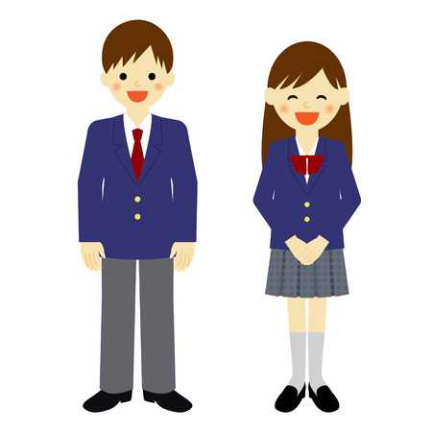


User Types
Teachers/staff
Students

Slide 6
User Types
Teachers/staff
View all activities
Create new activities
Modify activities
Create announcements to get more attention
Request staff/volunteers
Contact staff members for the activities they created
Students
View all activities
View all the announcement made
Show interest by attending an event
Become staff/volunteers

Slide 7
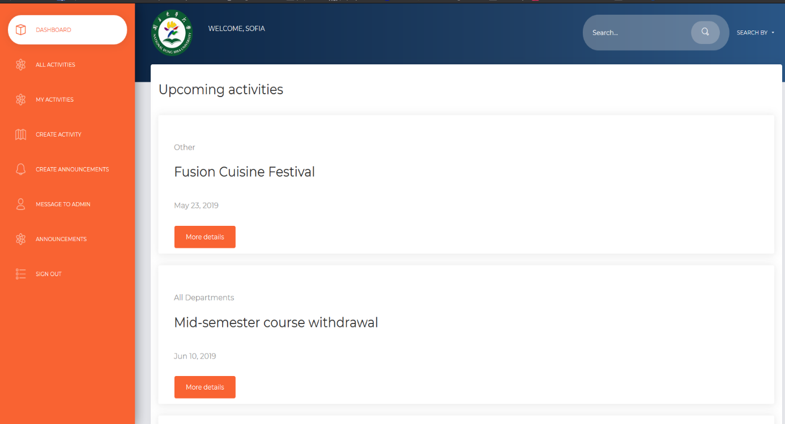
Interface
1
Main page

Slide 8
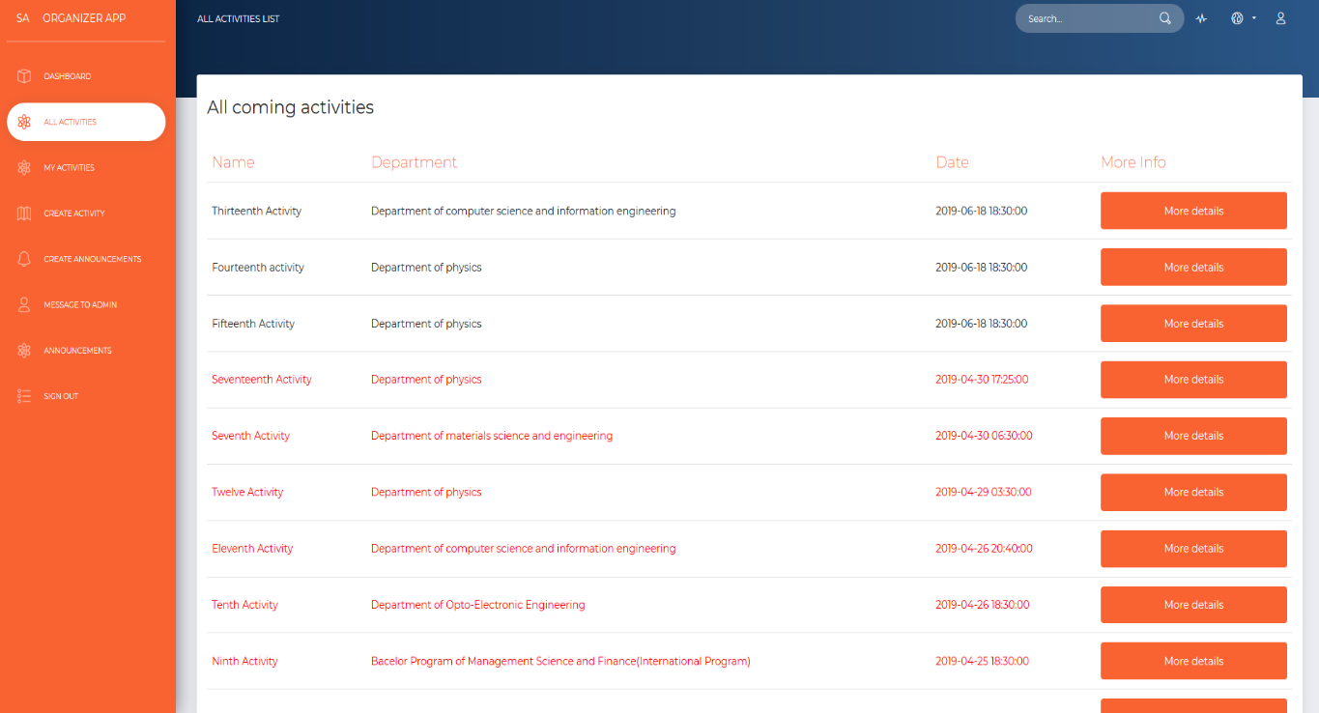
Interface
2
All activities view

Slide 9
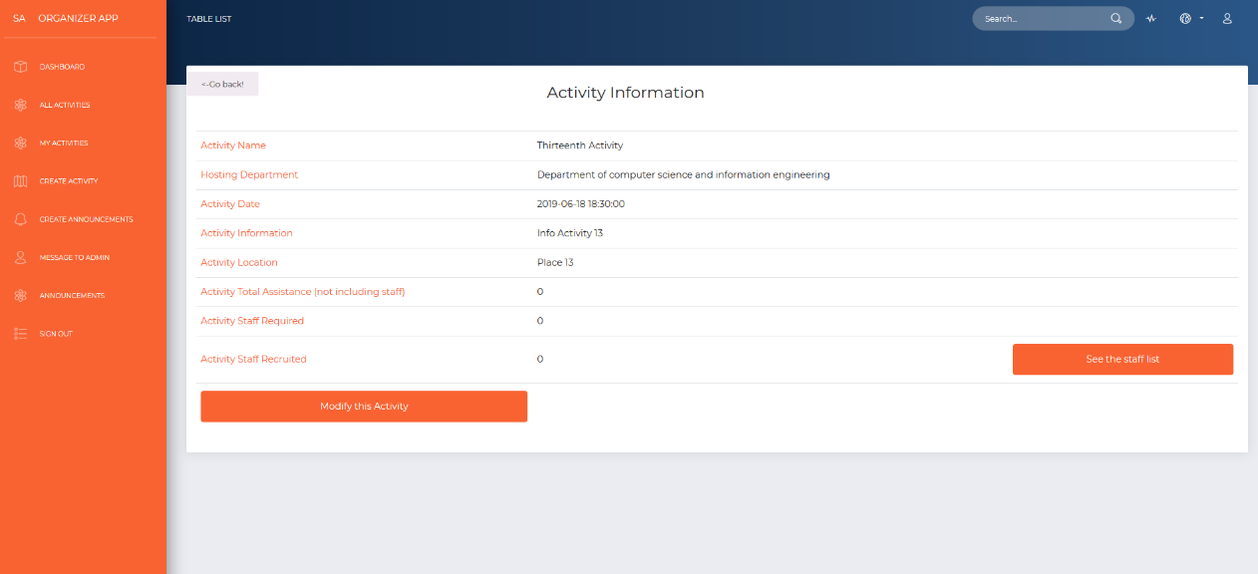
Interface
3
Activities Details

Slide 10
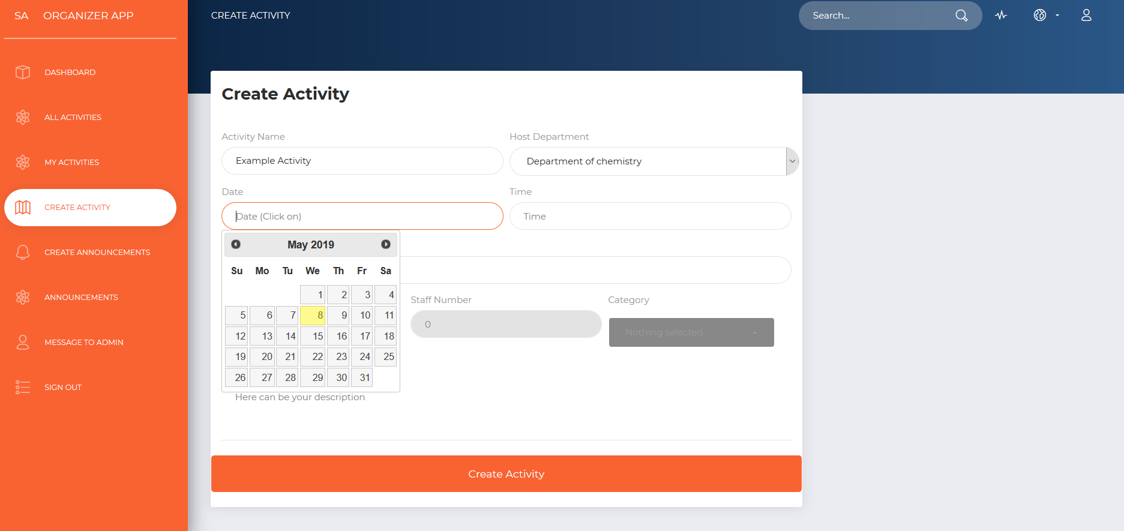
Interface
4
Create a new activity window

Slide 11
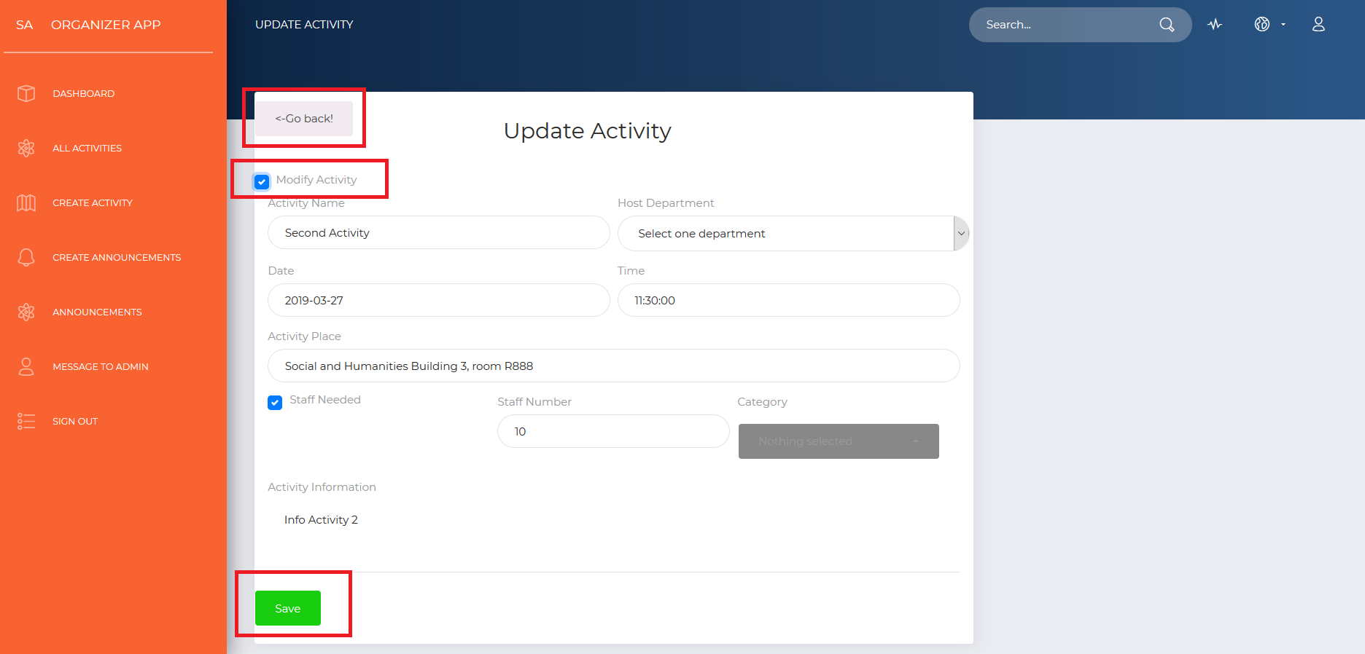
Interface
5
Edit / Modify an activity

Slide 12
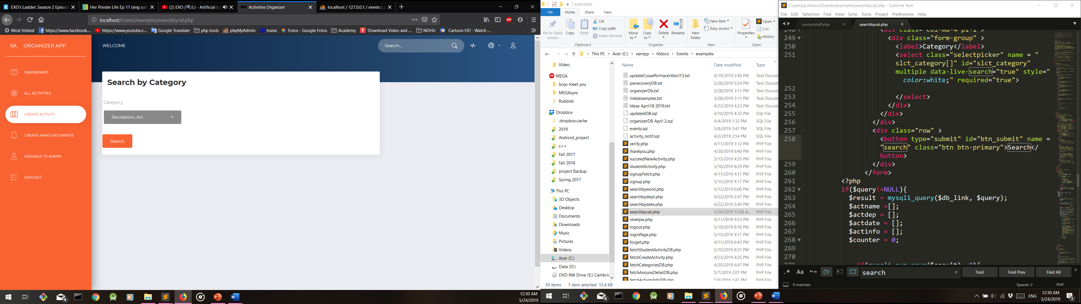
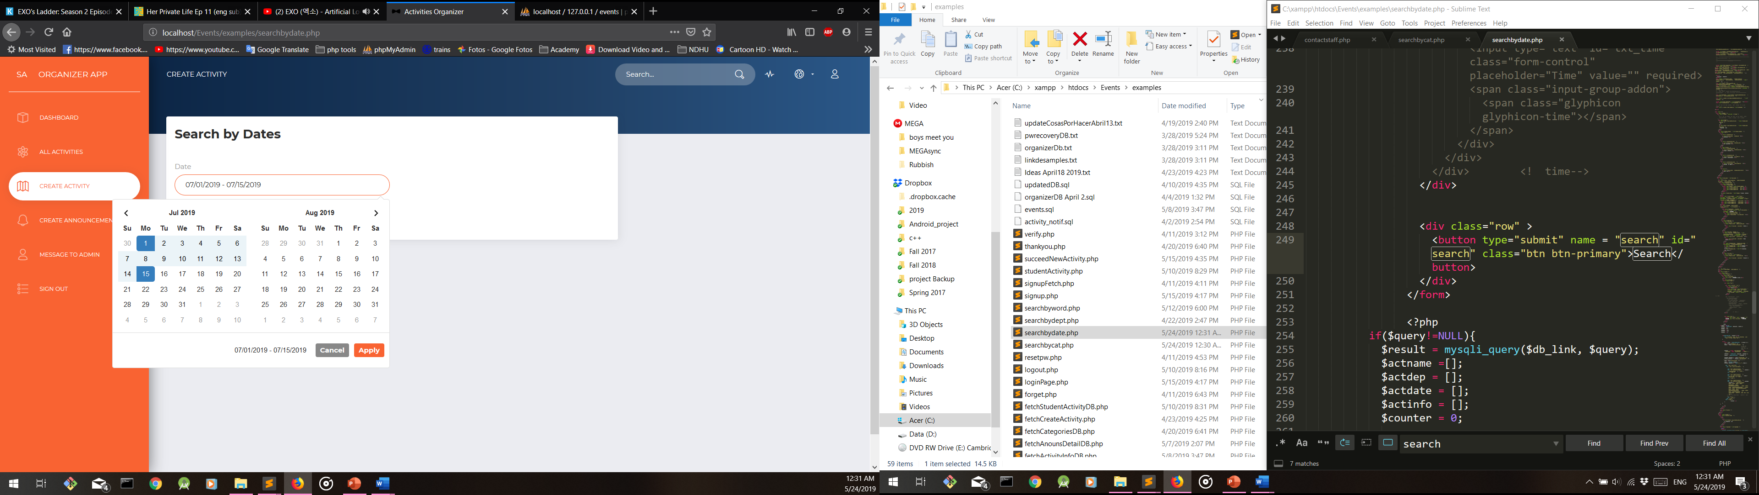
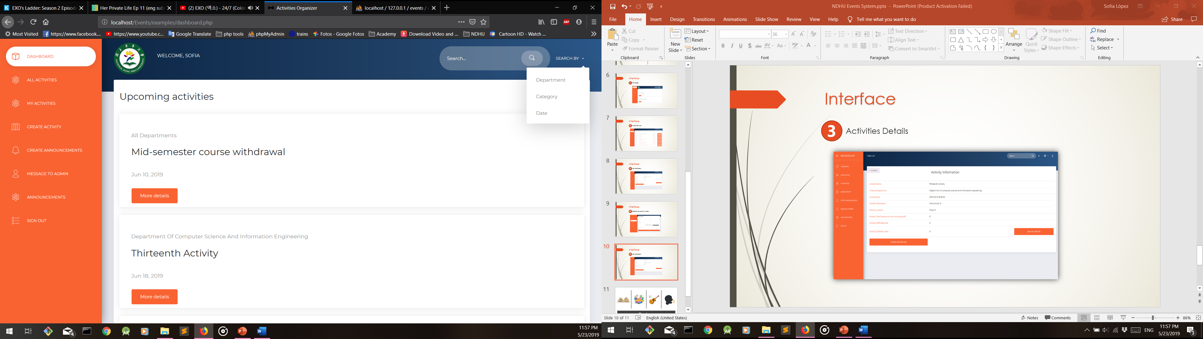
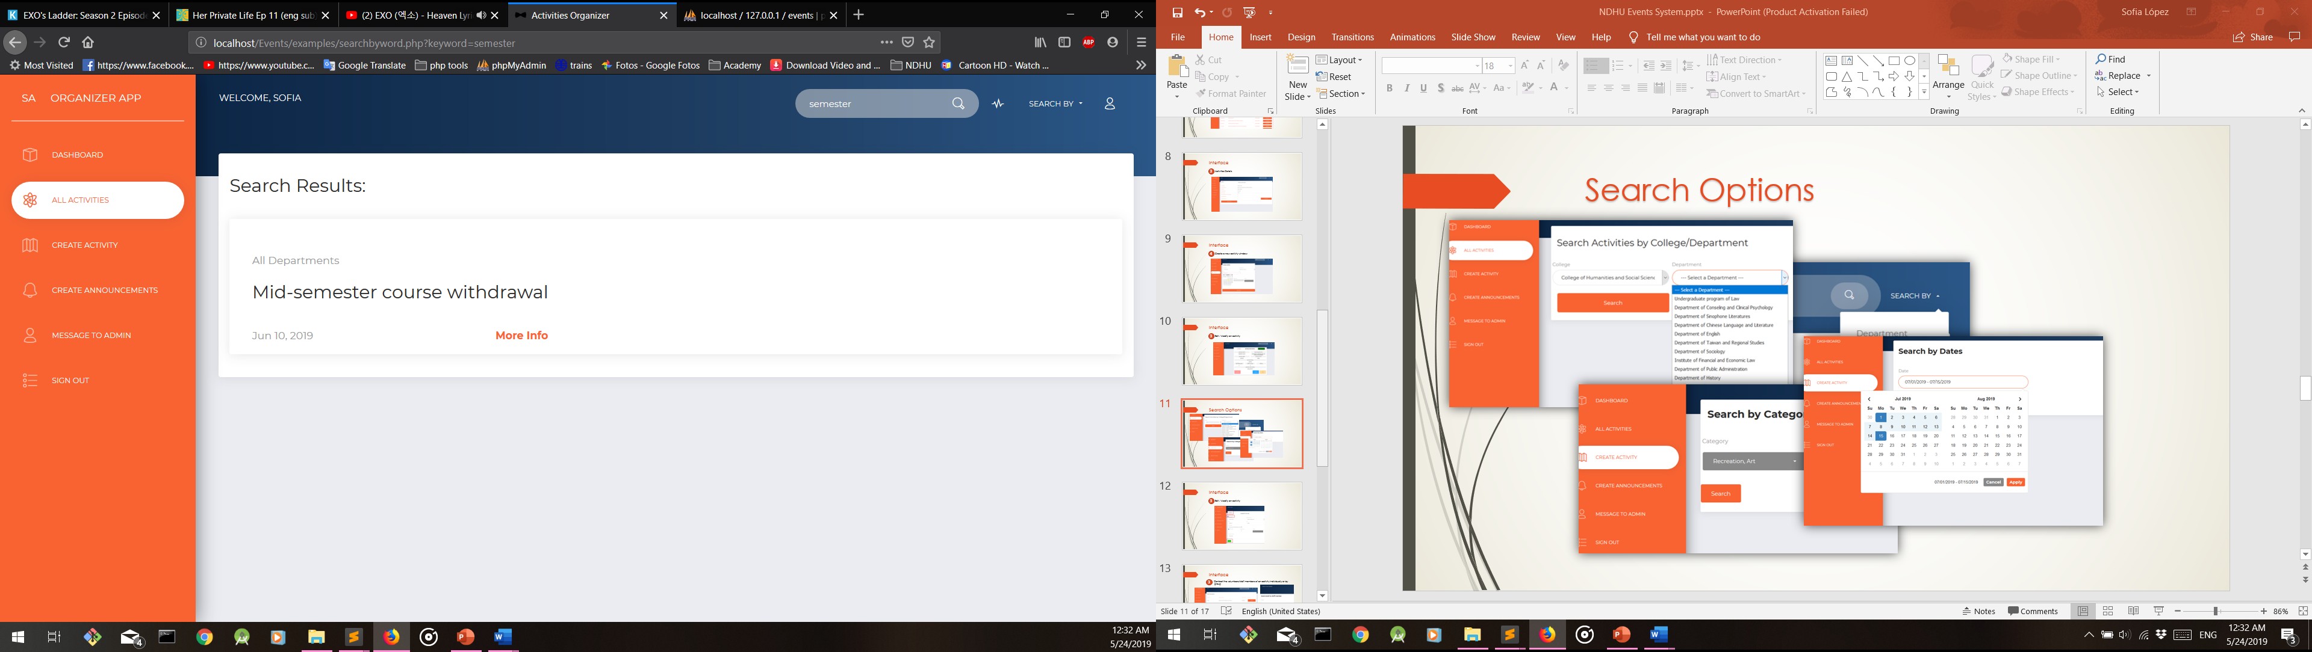
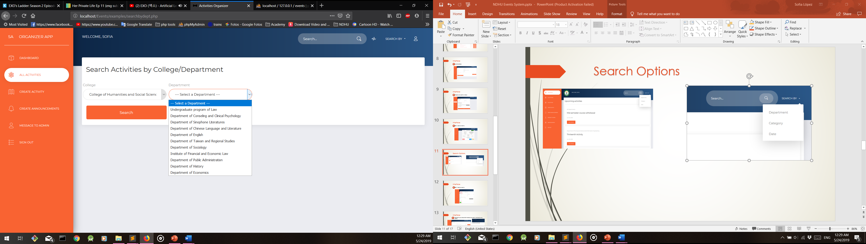
Interface
6
Search options

Slide 13
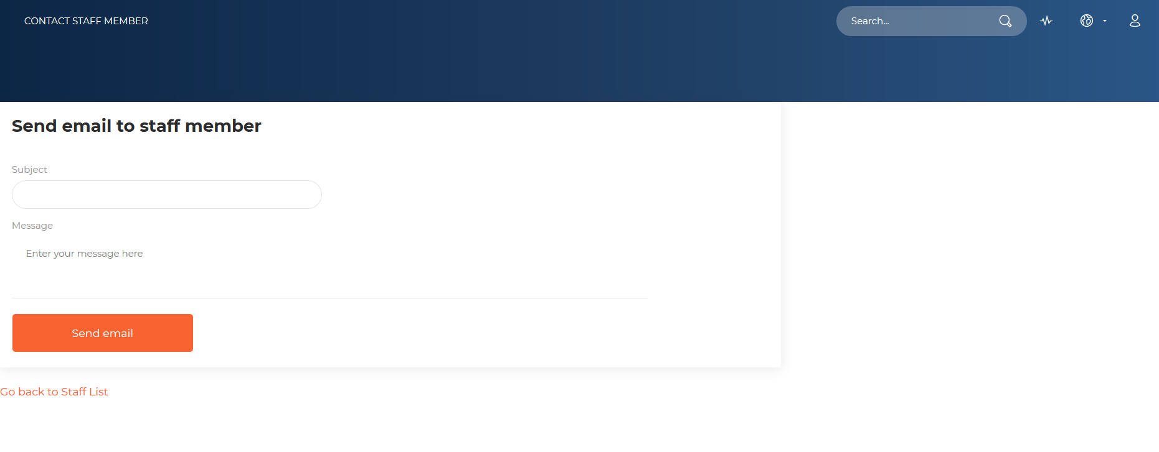
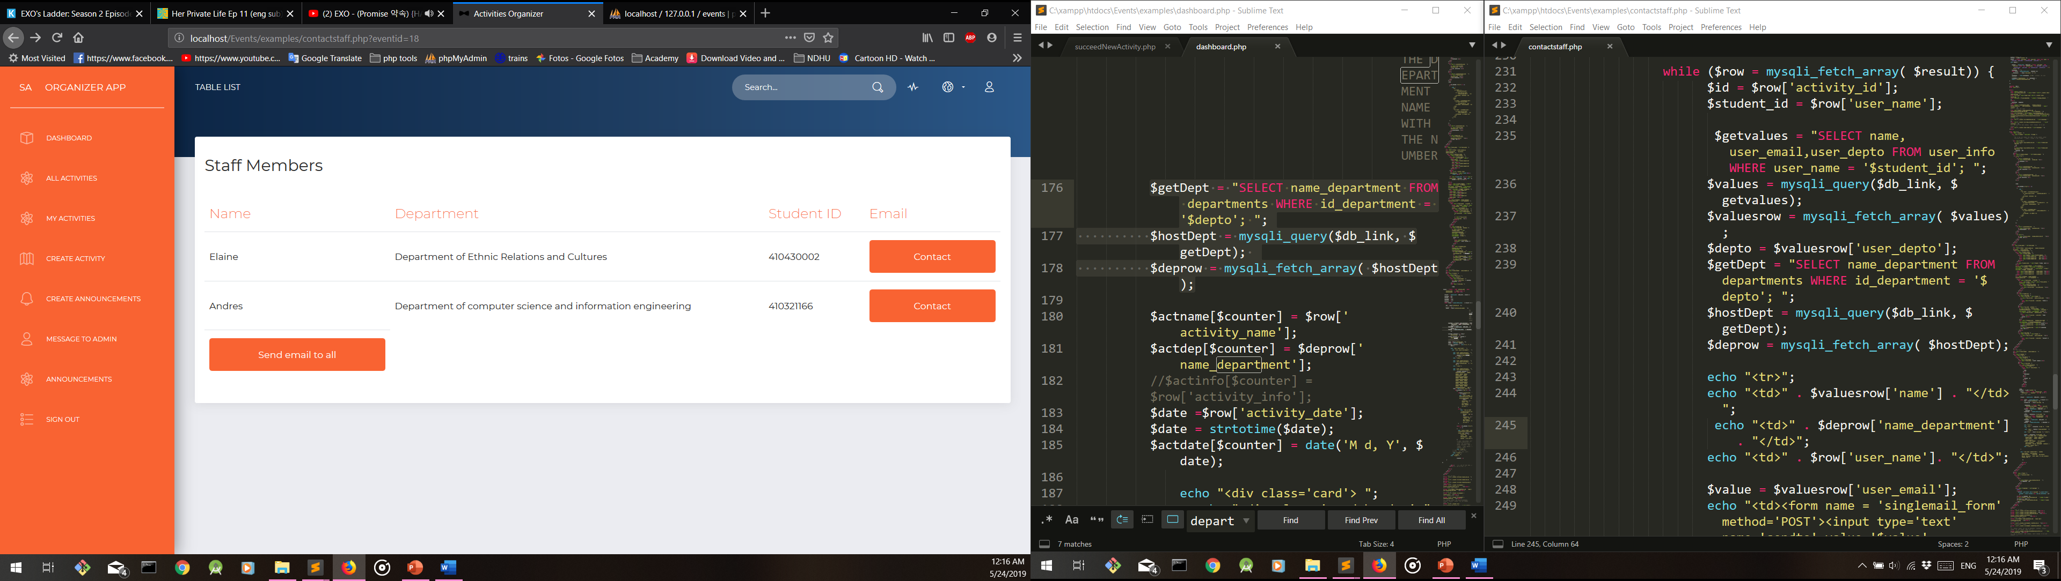
Interface
7
Contact the volunteers/staff members of an activity individually or by group

Slide 14
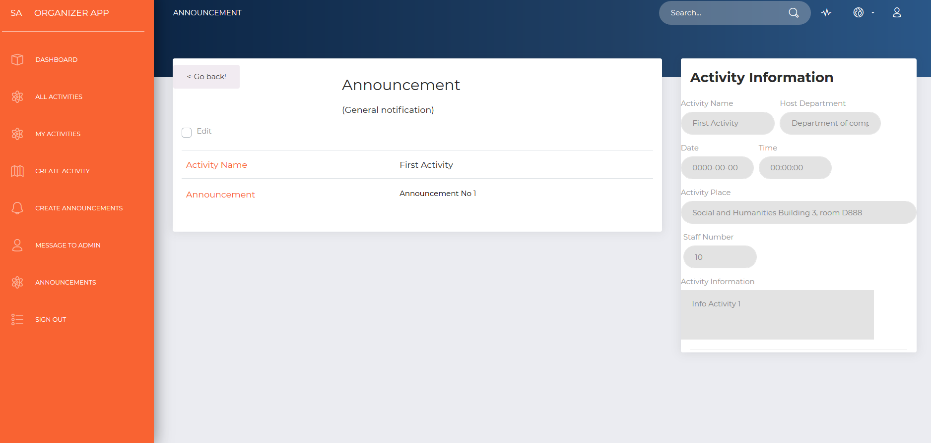
Interface
8
Create announcements that will get more attention for a specific public if needed

Slide 15
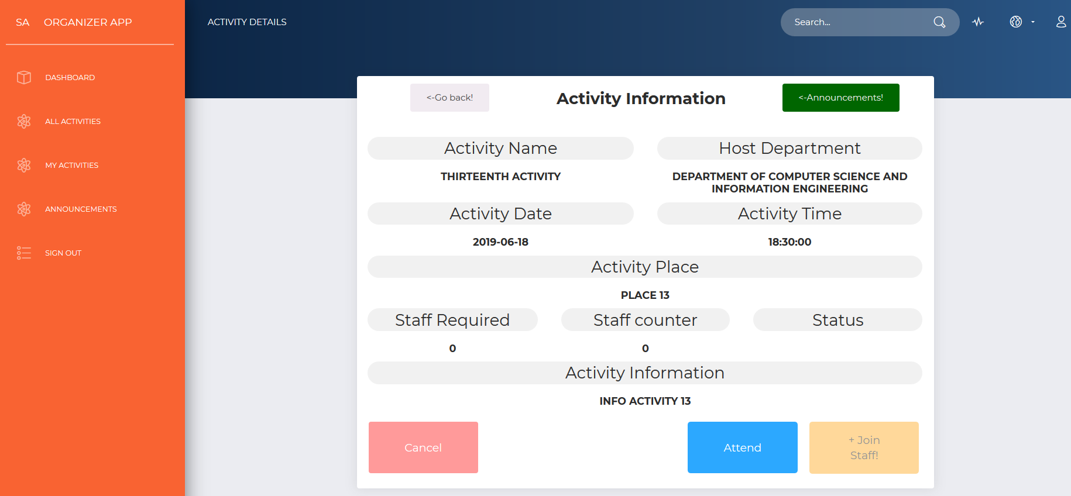
Interface
9
View activity details and show interest by attending or join the staff (Available for students)

Slide 16
Video Demonstration

Slide 17
Conclusion
Through the implementation of this system we hope that NDHU students can be more aware of what is happening around them, we believe this can help their overall experience in school and most importantly make sure that they do not miss any important event.

Slide 18
Thank you
Notes:
You can use this slide as your opening or closing slide. Should you choose to use it as a closing, make sure you review the main points of your presentation. One creative way to do that is by adding animations to the various graphics on a slide. This slide has 4 different graphics, and, when you view the slideshow, you will see that you can click to reveal the next graphic. Similarly, as you review the main topics in your presentation, you may want each point to show up when you are addressing that topic.
Add animation to images and graphics:
Select your image or graphic.
Click on the Animations tab.
Choose from the options. The animation for this slide is “Split”. The drop-down menu in the Animation section gives even more animations you can use.
If you have multiple graphics or images, you will see a number appear next to it that notes the order of the animations.
Note: You will want to choose the animations carefully. You do not want to make your audience dizzy from your presentation.

Slide 19
Q & A

